Slide 1

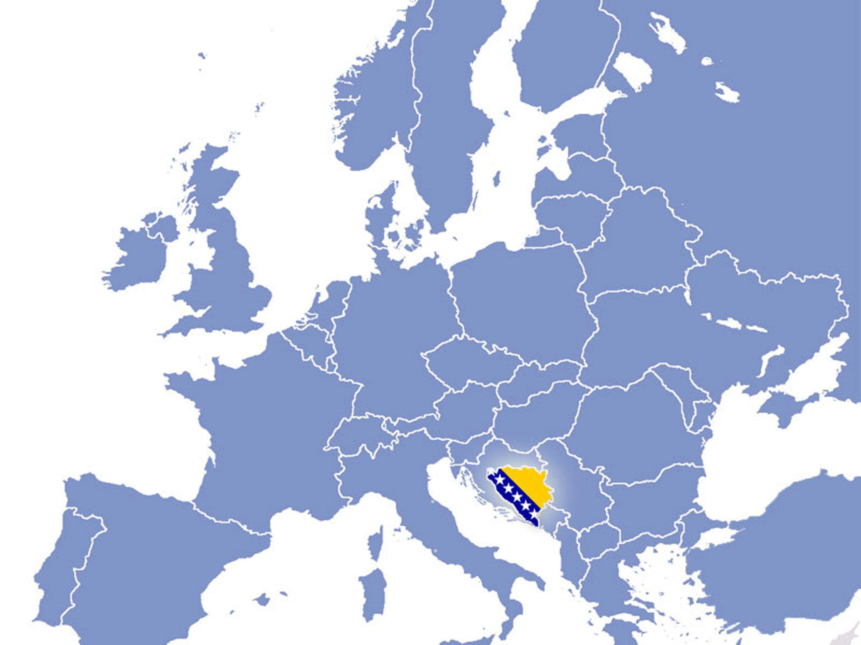

Invest in
Bosnia and Herzegovina
Your New Opportunity
BiH INVESTMENT OPPORTUNITIES

Slide 2

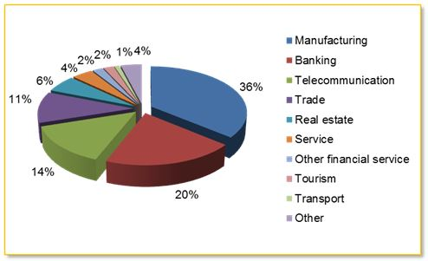
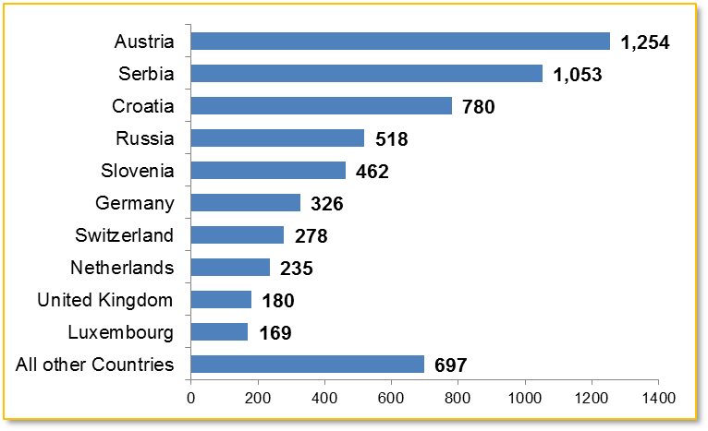
FDI in Bosnia and Herzegovina
Total FDI inflow, mill € Total FDI inflow:6 bill EUR
FDI by sectors, %
Source: Central Bank of BIH,* preliminary data
www.fipa.gov.ba
Our expectation, that FDI levels will increase in Bosnia and Herzegovina, are based on our investment opportunities, availability of natural resources and intention to privatize many strategic companies
Due to the good reputation and long industrial tradition of BiH, the manufacturing sector received the most amount of FDI
Top investors countries May 1994 - December 2014 (in mill)
European countries have invested more than 90% of total FDI in BiH

Slide 3








































They Have Already Invested

Slide 4


FDI from the Republic of Turkey (total amount 138.7 mili EUR – 12th place)
The biggest companies-investors
Investor (type of investment) | Domestic company | Sector
Kastamonu Entegre (Privatization) | "Natron-Hayat" d.o.o. Maglaj | Production
Soda Sanayii A.S. (Privatization) | „Sisecam Soda Lukavac“ d.o.o. Lukavac | Production
T.C. Ziraat Bankasi (Greenfield) | "Turkish Ziraat Bank Bosnia" d.d. Sarajevo | Banking sector
Yildirim Ozbek and others (Greenfield) | "Elit Foreign Trade" d.o.o. Sarajevo "DURU" d.o.o. Visoko | Trade and production
Ulusoy Hasan Ugur (Greenfield) | „Nobel Lijek“ d.o.o. Sarajevo | Trade
www.fipa.gov.ba

Slide 5








Reasons to invest in Bosnia and Herzegovina
Strategic
location
Favourable tax and customs system
Stable financial sector
Competitively priced and qualified human capital
www.fipa.gov.ba
Favourable trade and other agreements
Low operating costs
Natural resources and attractive investment locations and industrial zones
Favourable legal environment

Slide 6





Strategic location , Close to All Major European Capitals
A strategic location to European, Middle Eastern and Asian markets
Pan-European Corridor: Corridor Vc going from Hungary through Croatia and Bosnia and Herzegovina to the Port Ploce (Croatia)
Well developed road and railway network
4 international airports Banja Luka, Sarajevo, Mostar, Tuzla with
multiple daily flight to mayor Europan cities
2 river ports and 2 international ports
www.fipa.gov.ba
Sarajevo – Belgrade 206 km/ 128 miles
Istanbul 930 km/ 578 miles
London 1620 km/ 1006 miles
  Munich 708 km/440 miles
  Paris 1349 km/838 miles
Rome 516 km/320 miles
Vienna 511 km/317 miles
  Zurich 859 km/533 miles
Zagreb 288 km/179 miles

Slide 7


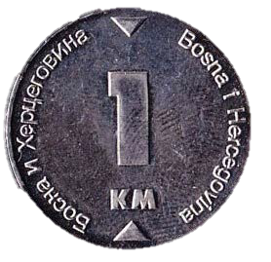

Safe investment environment
Resilient economy and investment destination
Most stable currency in the South East Europe linked to Euro 1 BAM = 0.51129 €
1 € = 1.95583 BAM
B+ credit rating with stable prospects by Standard&Poor
B2 credit rating with stable prospects by Moody's
High Central bank reserves
BiH's external debt is duly serviced.
It amounts to 4.19 billion KM or 16.9% of GDP
Gross foreign exchange reserves in the end of 2014 amounted to
KM 7.82 billion, with the annual growth in the amount of
KM 757.3 million (10.7%)

Slide 8
Safe investment environment
The lowest inflation in the Region
Source: Agency for Staristics of BiH, EDE (Emerging and Developing Europe), IMF (October 2015)
National treatment of a foreign investor
-Foreign investors are entitled to transfer abroad, freely
and without delay, in convertible currency, proceeds resulting
from their investment in BiH
-Protection against nationalization, expropriation or similar measures
-Foreign investors may own real estate in BiH-Foreign investors
enjoy the same property rights in respect to real estate as BiH legal entities

Slide 9
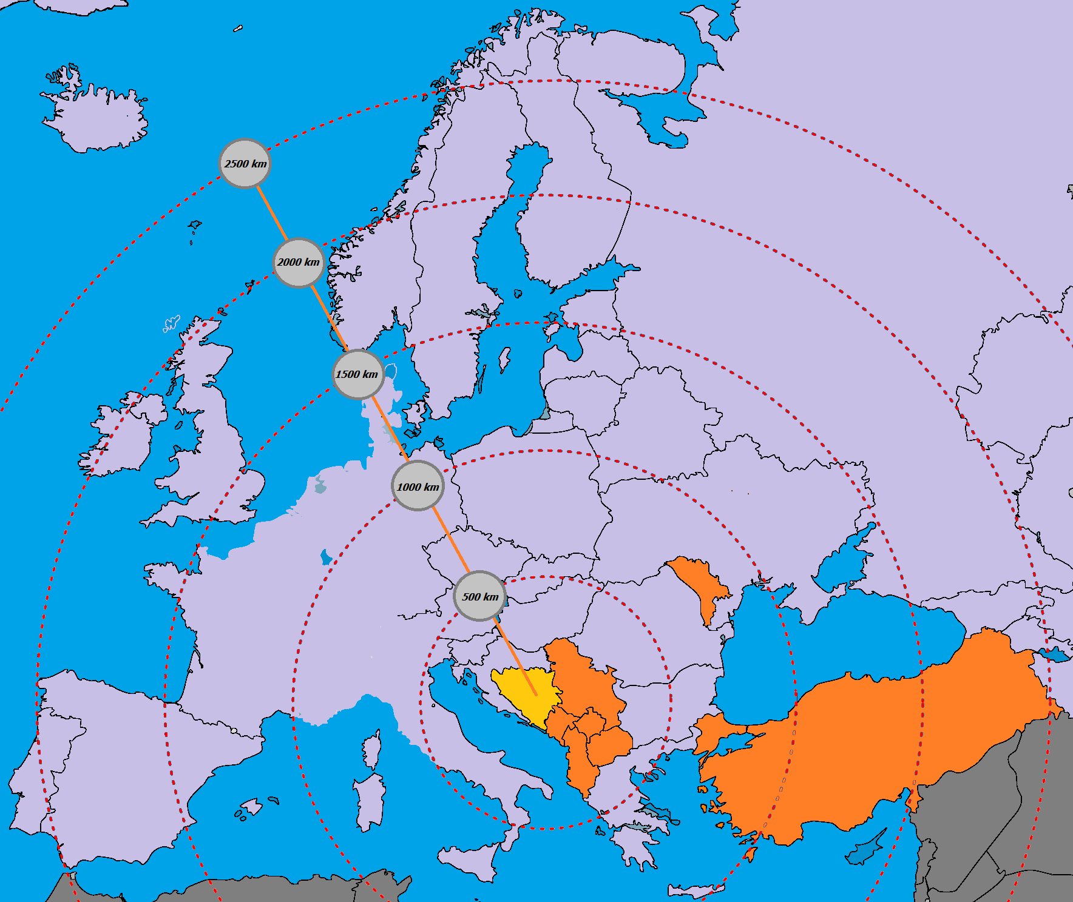
Liberal Foreign Trade Regime with a Major Number of Countries
Central European Free Trade Agreement (CEFTA) - 30 million
Free Trade Agreement with Turkey - 70 million
Free Trade Agreement with EFTA (Iceland, Liechtenstein, Norway, Switzerland) - 13 million
Preferential Trade Agreement with EU,
28 countries - 500 million
Preferential export regimes with USA, New Zealand, Japan, Russia, Kazakhstan,Belarus, Canada, Australia and Iran

Slide 10

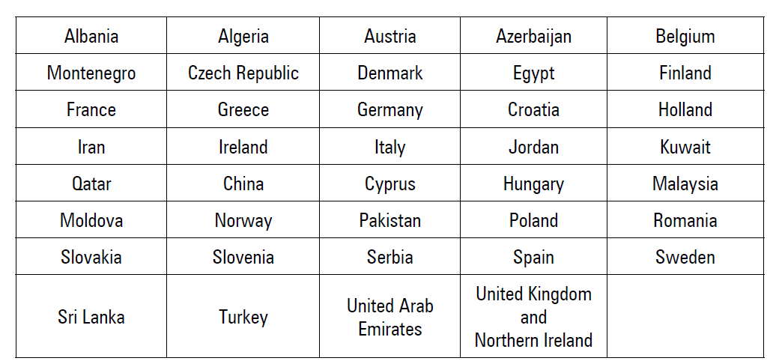
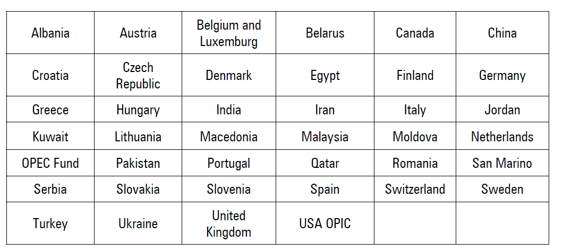
Agreements on Avoidance of Double Taxation, which mean that companies only have to pay tax in their home country, accelerate the flow of investments into the signatory countries, encourage joint ventures, create more investment opportunities etc.
Foreign investors can be insured against risks with the EU Investment Guarantee Trust Fund for Bosnia and Herzegovina, administered by the Multirateral Investment Guarantee Agency (MIGA, member of the World Banka Group).
Agreements on Avoidance of Double Taxation / Agreements on Promotion and Protection of Investments

Slide 11
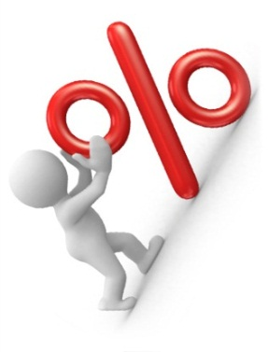
Favorable tax environment
VAT and CIT in Bosnia and Herzegovina are among the lowest
in the region and Europe
-18%
VAT (%)
CIT(%)
-Tax benefits
-Import of equipment that is a part of foreign investment is exempted from the payment of customs duties

Slide 12
Favorable tax environment
Corporate Tax Rates 2015
Source: https://www2.deloitte.com/

Slide 13
Favourable tax and custom system
The Federation Law on Corporate Income Tax enables foreign investors to enjoy the following benefits:
- The taxpayer who invests, from its own funds, in production equipment more than 50% of the total profit in the current tax period, shall be reduced of the obligation of the calculated tax for 30% of the amount in the year of investment.
- The taxpayer who in a period of 5 consecutive years makes investments from its own funds, in the total amount of 10 million €, starting with the first year when taxpayer has to invest at least 2 million €, shall be reduced of the obligations of the calculated income tax for 50% of the amount in the year of investment.
- The taxpayer is entitled to a tax-deductible expense in the double amount of the gross wage paid to newly employees if meets the following conditions:
duration of the employment contract must be at least for a period of 12 months with full-time working hour
new employee was not employed with the taxpayer or a related person in the previous five years.
In Republic of Srpska:
Law on Profit Tax RS introduced tax base reduction in the value of investment for:
- Investment in equipment intended for the company production activity
- Investments in plants and immovable property used for manufacturing and processing activities
And tax base reduction in amount of paid personal income tax and mandatory contribution for the employer:
- Employing 30 workers during a calendar year (workers who were on the official evidence of Employment Office of RS).
www.fipa.gov.ba

Slide 14
Skilled Labour Force
Highly talented, creative and skilled labor
Price competitive (in comparison to other EU countries)
A “can do” business attitude that reduces the risk of investment, within collaborative and innovative environment
Fluency in foreign languages - mostly English and German
Average net monthly wages, EUR (2015)
3.7 M
People
2.6 M
Working age people
1.1 M
Labour force

Slide 15
Competitive labour force
Each year the World Economic Forum has published The Global Competitiveness Report. Bosnia and Herzegovina's Availability of Scientists and Engineers Index for 2013 is 4.7, which gives the country a rank of 27 out of 148 countries with comparable data (the best rank in Region).
www.fipa.gov.ba
Source: The Global Competitiveness Report 2013-2014, WEF World Economic Forum
Bosnia and Herzegovina's Quality of math and science education Index for 2013 is 5,4(World Economic Forum - The Global Competitiveness Report. 2013-2014), which gives the country a rank of 13 out of 148 countries with comparable data. Bosnia and Herzegovina's Quality of management schools Index for 2013 is 4.7, which gives the country a rank of 41 out of 148 countries (also, the best rank in Region).

Slide 16
Operating costs – significantly lower than in EU
Electricity prices for medium size industries in 2015 - €/kWh
Source:http://ec.europa.eu/
www.fipa.gov.ba
Prices of real estate always depend on a number of factors such as: location, condition and equipment, age, current market situation. Prices of buying/leasing office space are ranging as follows:
Leasing office space (without ground floor): 5 EUR/m² – 20 EUR/m² per month
Buying office space:
Central position 1,500 EUR/m² – 3,000 EUR/m² ; Peripheral position 500 EUR/m² – 2,000 EUR/m²
Price of agricultural land: 2 EUR/m² – 25 EUR/m² ; Price of construction land: 25 EUR/m² – 700 EUR/m²
Prices of leasing/buying workshop (production building) are: Leasing production building: 2 EUR/m² – 10 EUR/m² per month
Buying production building: 50 EUR/m² – 1,000 EUR/m²
Source: Real Estate Agencies

Slide 17
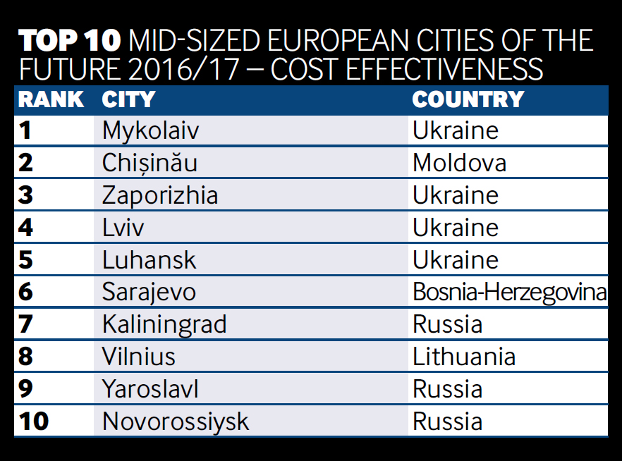
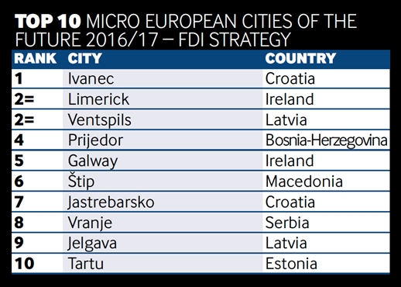
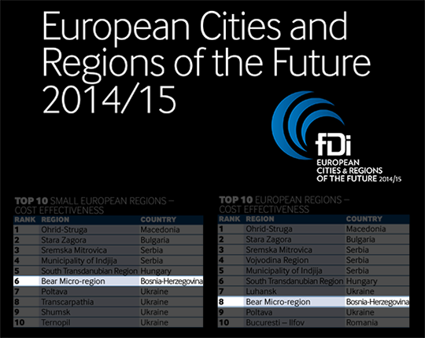
Recognitions

Slide 18
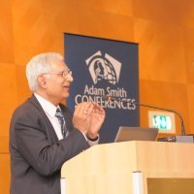
Recognitions
“... Natron has been one of the most successful privatisations in the country. That has happened not only because it had a very strong, determined and resourceful group behind it, but also because of very sincere dedicated, technically competent workforce in the mill and in the country which delivered the right results once guided properly.”
Mr. Avinash Taneja, Managing Director, Natron Hayat doo Maglaj (Turkey)

Slide 19



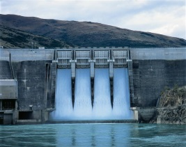



Energy sector
Natural resources and attractive investment locations–37% of total energy potentials
Potential of wind energy is estimated at 2000 MW ;
Theoretical potential of solar energy amounts about 74.65 PWh
Electricity export of ̴ 6000 GWh ranked BiH at 1st place in the region
Favourable and safe environment for investment
Favourable Feed-in-tariffs
B i H is on the 8th place in Europe with 6,000 MW hydro energy potential and possible annual production of 99.256 GWh
www.fipa.gov.ba

Slide 20








Agriculture and Food Processing sector
to Fertile and unpolluted soils, abundance of fresh water resources and favorable and varied climactic conditions remain an untapped resource at very competitive costs
BiH is a leading producer of raspberries (10th in the world), plums (15th), strawberries (35th) and offers high quality vegetables including among others potatoes, peppers, cabbage and cucumber
Average annual fresh milk export growth rate was 8% in the period of 2008/2015
Excellent opportunity to cover the Balkan market demand as well as BIH, which imports over 75% of its food and agricultural product needs
.
www.fipa.gov.ba

Slide 21









Wood Industry
63% of BiH territory is covered in forests
Unparalleled access to natural resources, including different types of timber
A large and productive workforce skilled in wood processing, furniture, wood flooring and other verticals
A wood products laboratory and testing facility to increase research and development capabilities, lower costs, and create greater market access
Tradition in wood production and processing that provides strong access to existing and emerging markets
www.fipa.gov.ba

Slide 22
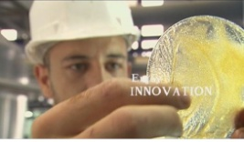
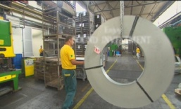






Metal Processing Industry
Leading export sector in BiH economy with 10% annual growth rate over the past years
Manufacturing support from beginning to an end – from raw materials, through design, engineering and development phase, as well as maintenance support
A large and productive workforce skilled in metal production and processing
Tradition in metal production and processing that provides strong access to existing and emerging markets
Unique natural resources, such as iron ore, bauxite, lead, zinc, and copper
Low utility costs, which provides a distinct cost advantage to investors

Slide 23


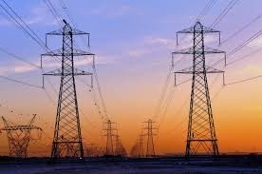





Automotive Parts and Manufacturing
Geographical proximity to automotive manufacturing base in Europe allows foreign investors low distribution costs and “just-in-time” production delivery
Constant export growth and reputable customers
Availability of research and development institutes
6 Faculties of Mechanics)
Quality production – ISO and industry certificates
Infrastructure in place and energy sources available at lower costs than in surrounding countries
www.fipa.gov.ba

Slide 24




Information and Communications Technology
Technology parks/facilities that provide a world-class support network for ICT companies, including on-demand training, modern facilities, and state-of-the-art infrastructure
Availability of high-quality engineering, science, and ICT graduates, with workforce supply of over 100,000 skilled individuals and with over 1,200 university graduates in ICT
A competitive cost environment that merges world-class ICT skills with reasonable wage rates and cost of doing business
A growing number of connecting points for ICT companies, allowing them to undertake research and development
.
www.fipa.gov.ba

Slide 25
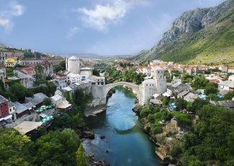
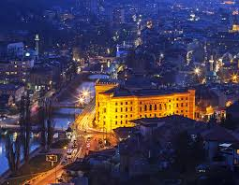
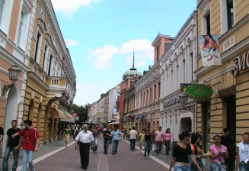
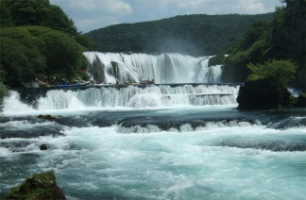
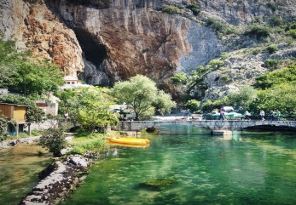
Tourism
New Unexplored Destination
-Health and Spa
-Ecotourism
-Ski and Mountain
-Cultural Heritage & -Religious tourism
-Adventure tourism
-Sea tourism
BiH becomes an emerging tourism destination
Unexplored and untouched natural beauties
-Opening and construction of new tourism resorts
-Upgrading of existing resorts
-Hotels privatization
-Nature Parks commercialization
-Resort operators
-Investment in supporting infrastructure
-Excellent climate conditions
-Long tradition in winter tourism
-Favourable legal environment with guarantees and right protecting your investment
www.fipa.gov.ba

Slide 26
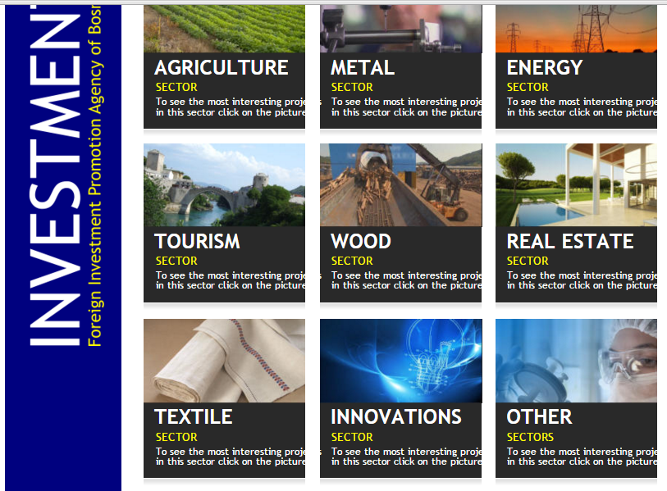
www.fipa.gov.ba

Slide 27

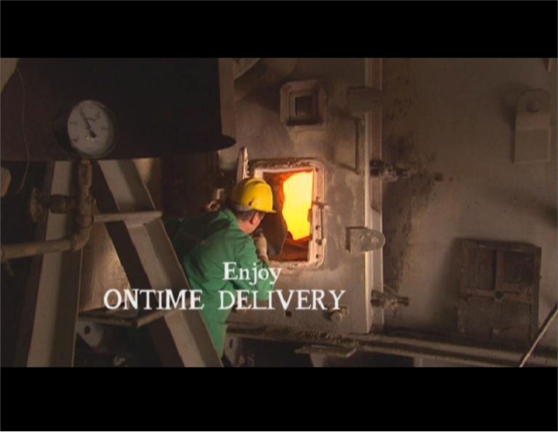



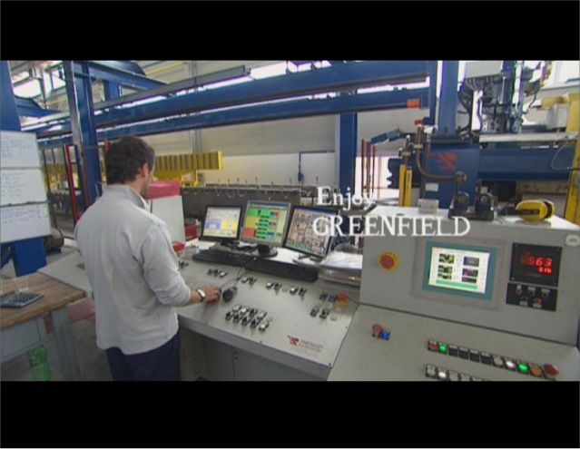
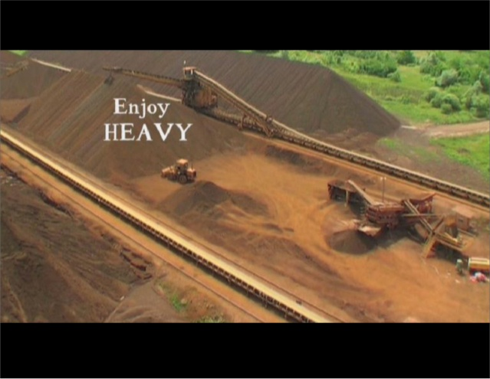


Natural resources and attractive investment locations and industrial zones
Greenfield location
Brownfield location
Privatisation process
Bankruptcy opportunities
Concessions
Joint ventures
Investment projects
www.fipa.gov.ba

Slide 28
FIPA support
Providing of all information related to BiH business environment
Analysis and presentation of attractive sectors for foreign investors
Servicing potential and existing investors, especially during the process of business registration
Legal advice for foreign investors
Investor after-care
Policy advocacy
Good co-operation with all levels of Government in BiH
OUR SERVICES ARE FREE AND CONFIDENTIAL!
www.fipa.gov.ba

Slide 29
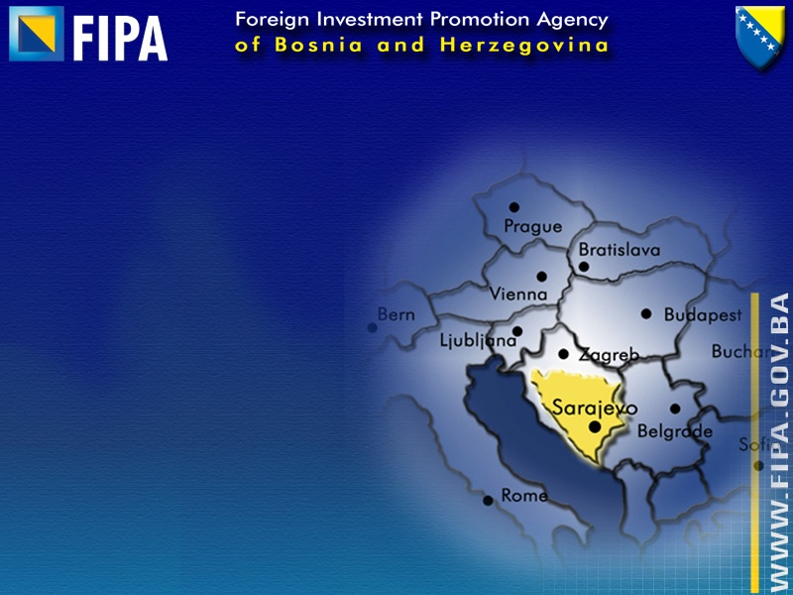
FIPA contacts
Sarajevo Office
Grbavicka 4
Phone: +387 33 278 080
Fax: +387 33 278 081
E-mail: fipa@fipa.gov.ba
Nina Pobrić
Head of the Investment Promotion Department
Tel: +387 33 278 082
E-mail: nina.pobric@fipa.gov.ba
Banja Luka Office
Jovana Surutke 13/III, Office A52
Phone/ Fax: : +387 51 226 180
E-mail: banjaluka@fipa.gov.ba
www.fipa.gov.ba
Mostar Office
Kneza Višeslava, Office 54
Phone /Fax: +387 36 558 815
E-mail: mostar@fipa.gov.ba

Slide 30


